Slide 1
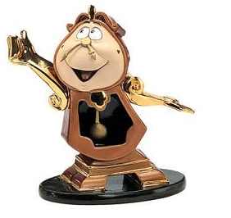
What time is it?
Que horas sao

Slide 2
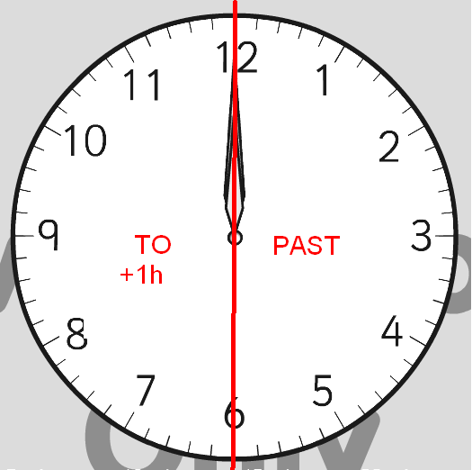
Time = tempo ou hora
Para
passado

Slide 3
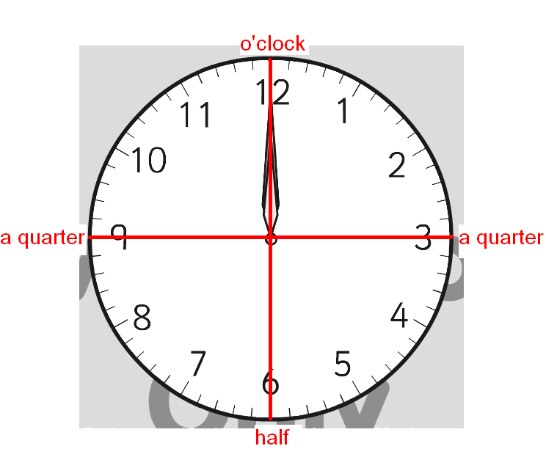
Em ponto
Um quarto
metade

Slide 4
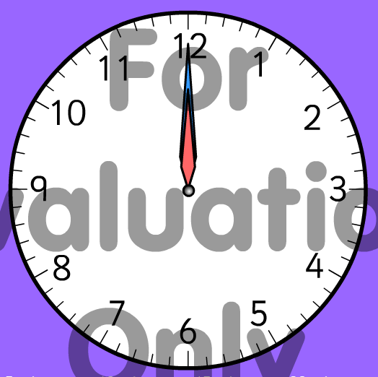
It’s twelve o’clock.
(or)
It’s twelve.
(Or)
It's Midday (dia)
It's noon (dia)
It's midnight (noite)

Slide 5
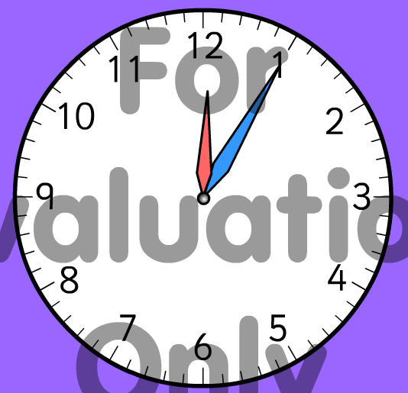
Time = tempo ou hora
It’s twelve oh five.
(or)
It’s five past twelve.
Nos dois casos pode usar junto:
Am (noite)
ou
Pm (tarde)

Slide 6
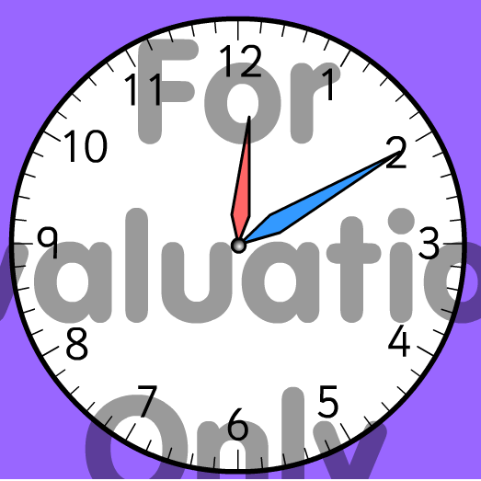
Hora = Hour
It’s twelve ten.
(or)
It’s ten past twelve.

Slide 7
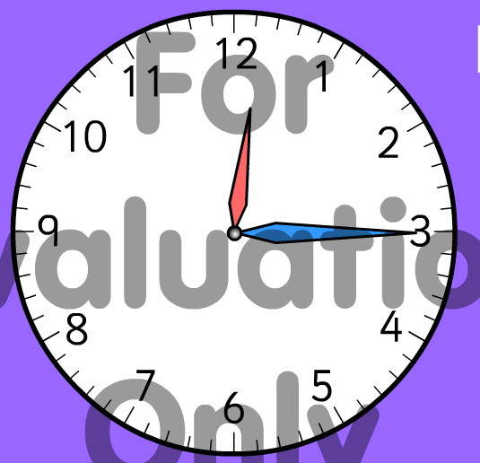
Time = hora ou tempo
It’s twelve fifteen.
(or)
It’s fifteen past twelve.
(or)
It’s a quarter past twelve.

Slide 8
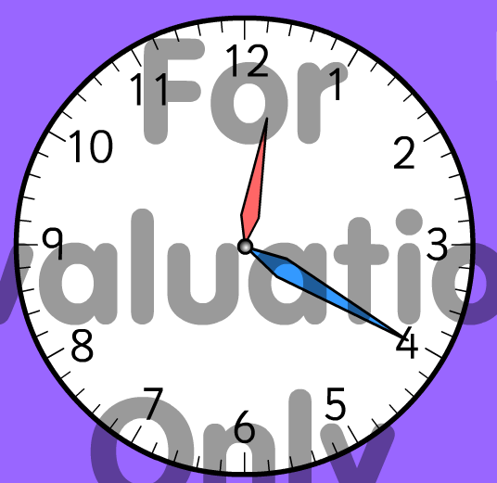
Time = tempo = hora
It’s twelve twenty.
(or)
It’s twenty past twelve.

Slide 9
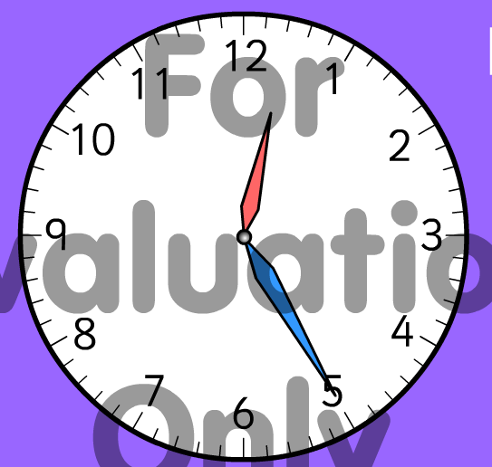
It’s twelve twenty five.
(or)
It’s twenty five past twelve.

Slide 10
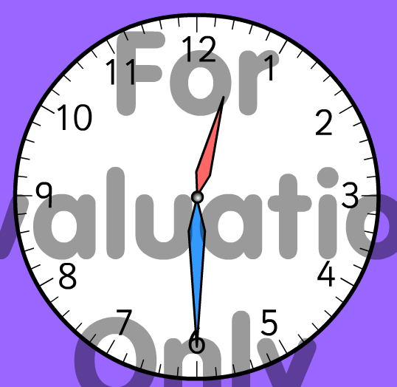
It’s twelve thirty.
(or)
It’s half past twelve.

Slide 11
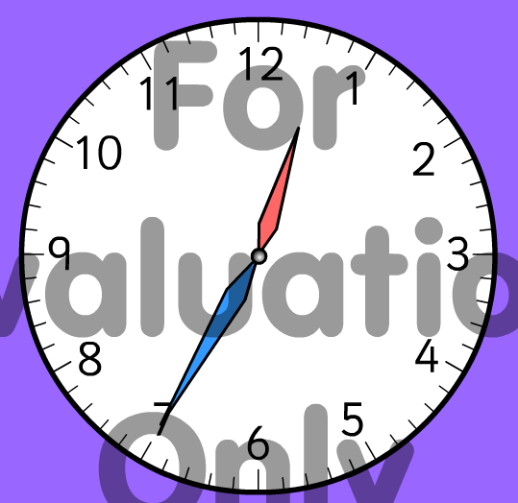
It’s twelve thirty five.
(or)
It’s twenty five to one.

Slide 12
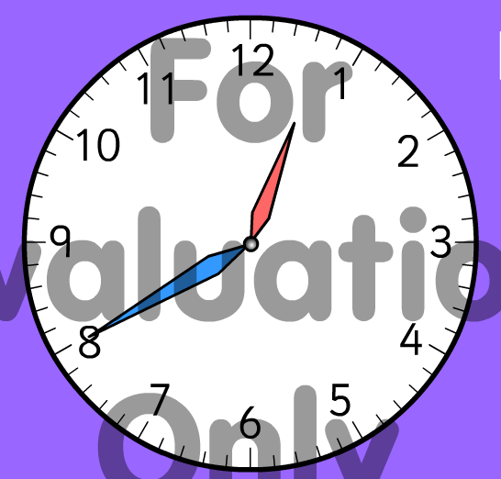
It’s twelve forty.
(or)
It’s twenty to one.

Slide 13
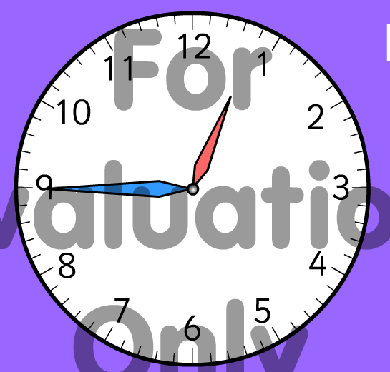
It’s twelve forty five.
(or)
It’s fifteen to one.
(or)
It’s a quarter to one.

Slide 14
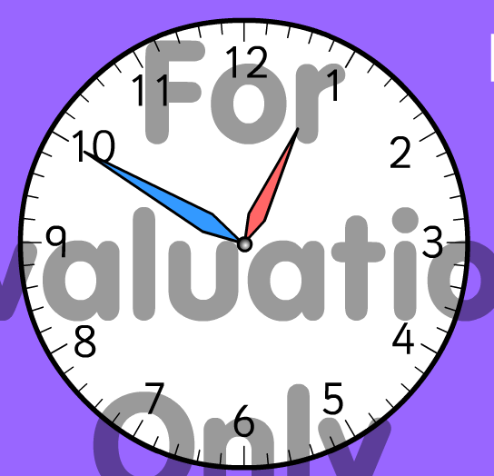
It’s twelve fifty.
(or)
It’s ten to one.

Slide 15
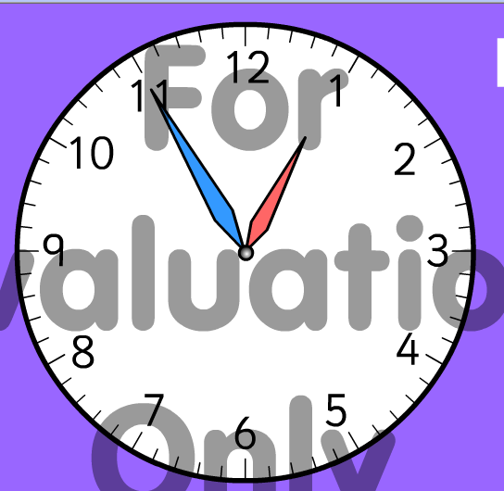
It’s twelve fifty five.
(or)
It’s five to one.

